Slide 1

Transforming the User Experience: A Website Improvement Proposal for Cal State LA
Gabriela Gonzalez
Rafael Cruz
CIS 5620

Slide 2

AGENDA
Overview
Motive
Audience
Website

Slide 3
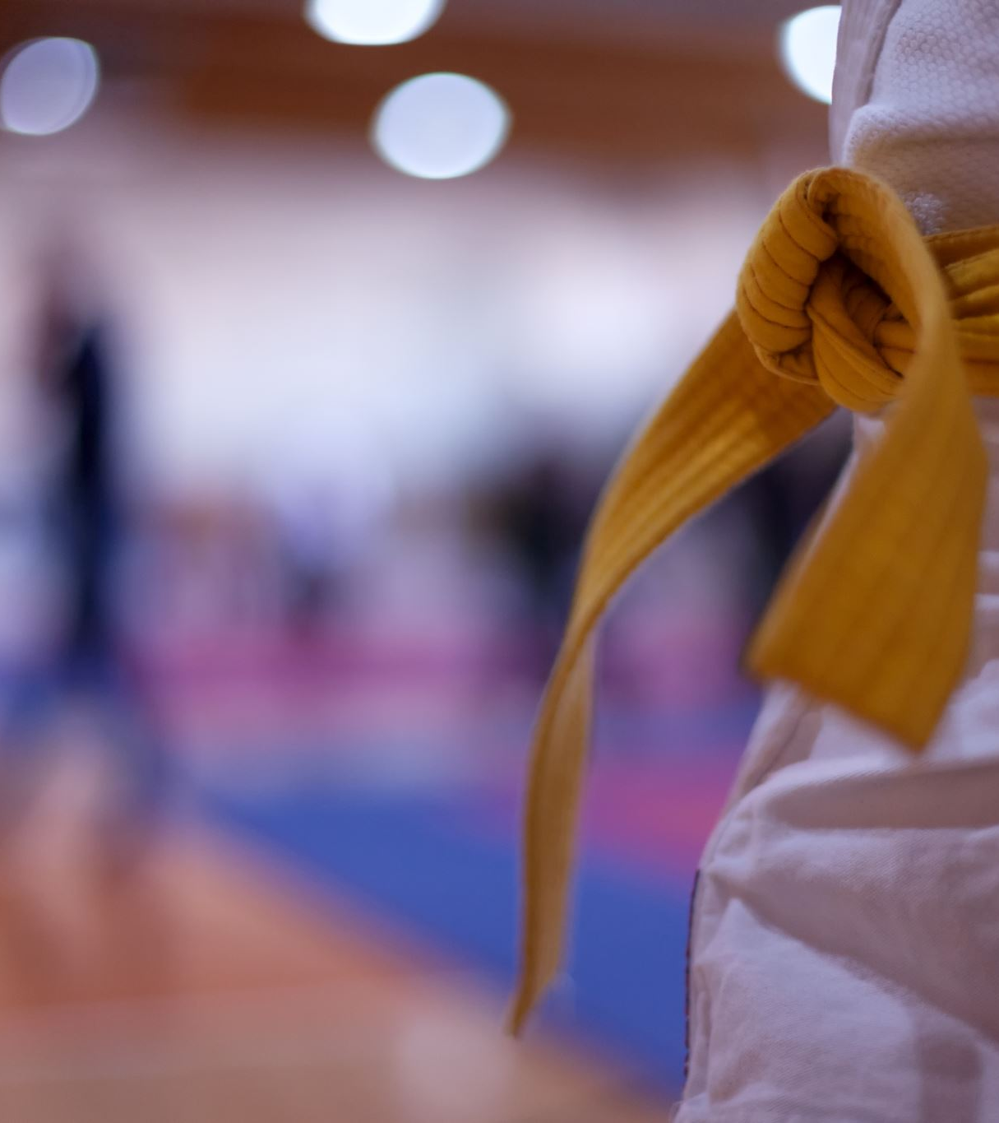

Fun Facts
Founded in 1947 as Los Angeles State College
Formerly Diablos, the Golden Eagle became the mascot in 1981
In 1984, Cal State LA was the site of the XXIII (23rd) Olympiad judo events
During the 2021-2022 cycle, 27,032 active students – 13.8% graduate/Postbacc students
1268 New Graduate/Postbacc Students
Cal State LA kicked off the university's 75th anniversary celebration with the University Convocation

Slide 4

Motive
TO IMPROVE USER EXPERIENCE
The current website may not provide users with a seamless and intuitive experience.
will keep up with technological advancements to provide a website that is clear and user friendly for current and perspective students of Cal State LA

Slide 5
Target Audience Motivation and Goals
Serving as .the initial point of contact, the website is intended to target both present and potential Cal State LA students wishing to further their education in the city of Los Angeles
The redesigned Cal State LA Admissions website will inspire students seeking degrees by giving them the resources they need to:
Go/Return to the university
Residency information

Slide 6

Website
https://ggonza156.github.io/CIS5620Project/

